Slide 1

Welcome
This was a PowerPoint, now it’s a video!
Notes:
Hello everyone my name is Ben, and welcome to the Beckhoff AU PowerPoint to video conversion tool. I'll now guide you through some of the key features.

Slide 2
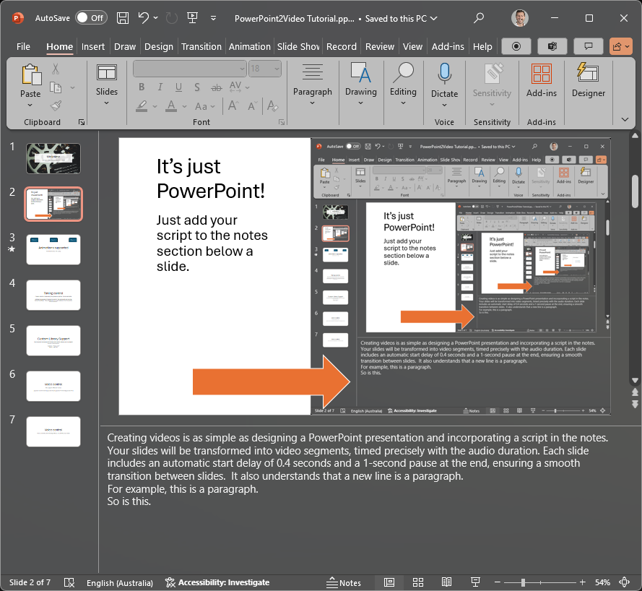
It’s just PowerPoint!
Just add your script to the notes section below a slide.
Notes:
Creating videos is as simple as designing a PowerPoint presentation and incorporating a script in the notes. Your slides will be transformed into video segments, timed precisely with the audio duration. Each slide includes an automatic start delay of 0.4 seconds and a 1-second pause at the end, ensuring a smooth transition between slides. It also understands that a new line is a paragraph.
For example, this is a paragraph.
So is this.

Slide 3
Animations supported
Takes 1s
Takes 7s
Takes 1s
Total Animation Time (9s)
Notes:
The tool supports animations. If the animations on your slides are longer than the accompanying audio, the duration of these animations will determine the length of the video.

Slide 4
Timing control
Pauses can be made using the {pause x} syntax. X is in seconds. Adding {no pause} at the start or end of the notes will remove the default padding. This is helpful if you want slides to fast transition mid sentence.
Notes:
Pauses can be integrated into the video using the pause syntax shown on the slide. For instance, I will now pause for 3 seconds. {pause 3} Additionally, it is possible to eliminate the start and end delays by applying the no-pause syntax at the beginning or end of the notes.

Slide 5
Custom Library Support
The converter features a dictionary.json which allows you to program custom conversions. TwinCAT = “twin-cat” 4024 = “40 24”
Notes:
The converter features a dictionary which allows you to program custom conversions. This allows you to control how key words are spoken. For example, TwinCAT, EtherCAT, and 4024 will be converted to their preferred pronunciation. This keeps your PowerPoint scripts decluttered.

Slide 6
Voice control
We support different voices {speaker ‘automation’} {speaker ‘ipc’} {speaker ‘io’}{speaker ‘motion’}
Notes:
{speaker ‘automation’} Hi, my name is Ben and I'm the automation specialist. {speaker ‘ipc’} Hello, I'm the IPC specialist. {speaker ‘io’} Hi, I'm the IO specialist. {speaker ‘motion’} Hello, I'm the motion specialist; it’s good to meet you

Slide 7
Voice control
Voice control automatically follows on with the next slide
Notes:
The tool remembers what voice you have selected. {speaker ‘automation’} If you have any questions or would like to know more, please reach out.

